Slide 1
Pavement Condition Monitoring and Maintenance Prediction
A city engineering office tasked with identifying which road segments require urgent maintenance.

Slide 2
Aim
The goal is to analyze this data and build a binary classification model to predict whether a given road segment needs maintenance, based on pavement and environmental indicators.
Target Variable : Needs_Maintenance
This binary label indicates whether the road segment requires immediate maintenance, defined by the following rule:
Needs_Maintenance = 1
Needs_Maintenance = 0 otherwise

Slide 3
Data Ditcionary
The office has collected inspection data on various roads, including surface conditions, traffic volume, and environmental factors.
1050000 rows × 10 column (after Feature Enginnering 1016793 rows × 17 columns)
Segment ID : Unique identifier for the road segment
PCI : Pavement Condition Index (0 = worst, 100 = best)
Road Type : Type of road (Primary, Secondary, Barangay)
AADT : Average Annual Daily Traffic
Asphalt Type : Asphalt mix classification (e.g. Dense, Open-graded, SMA)
Last Maintenance : Year of the last major maintenance
Average Rainfall : Average annual rainfall in the area (mm)
Rutting : Depth of rutting (mm)
IRI : International Roughness Index (m/km)
Needs Maintenance : Target label: 1 if urgent maintenance is needed, 0 otherwise

Slide 4
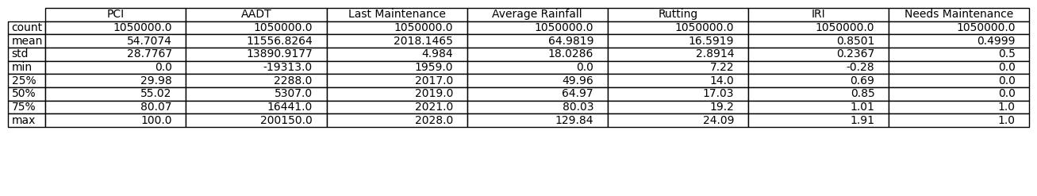
Data Summary
Note : As you in data summary(desciption) AADT and IRI has min value as -19313 and -0.28 respectively which is note correct as minimum value for AADT and IRI is 0.0, hence data has serious Outliers(Noices). Also Last maintenance column which has maximum value 2028 and as currently we are in 2025, A road maintained in 2028 is not possible, Hence Last Maintenance column also has Outliers(Noice).

Slide 5
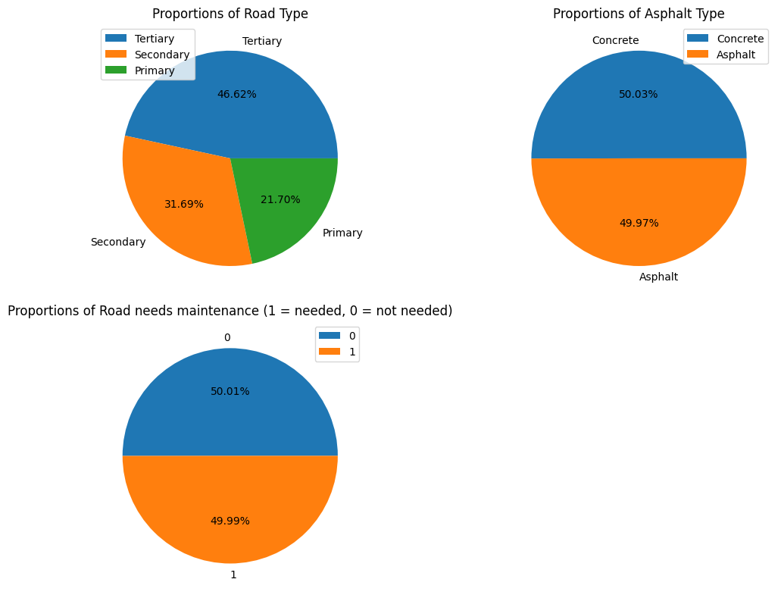
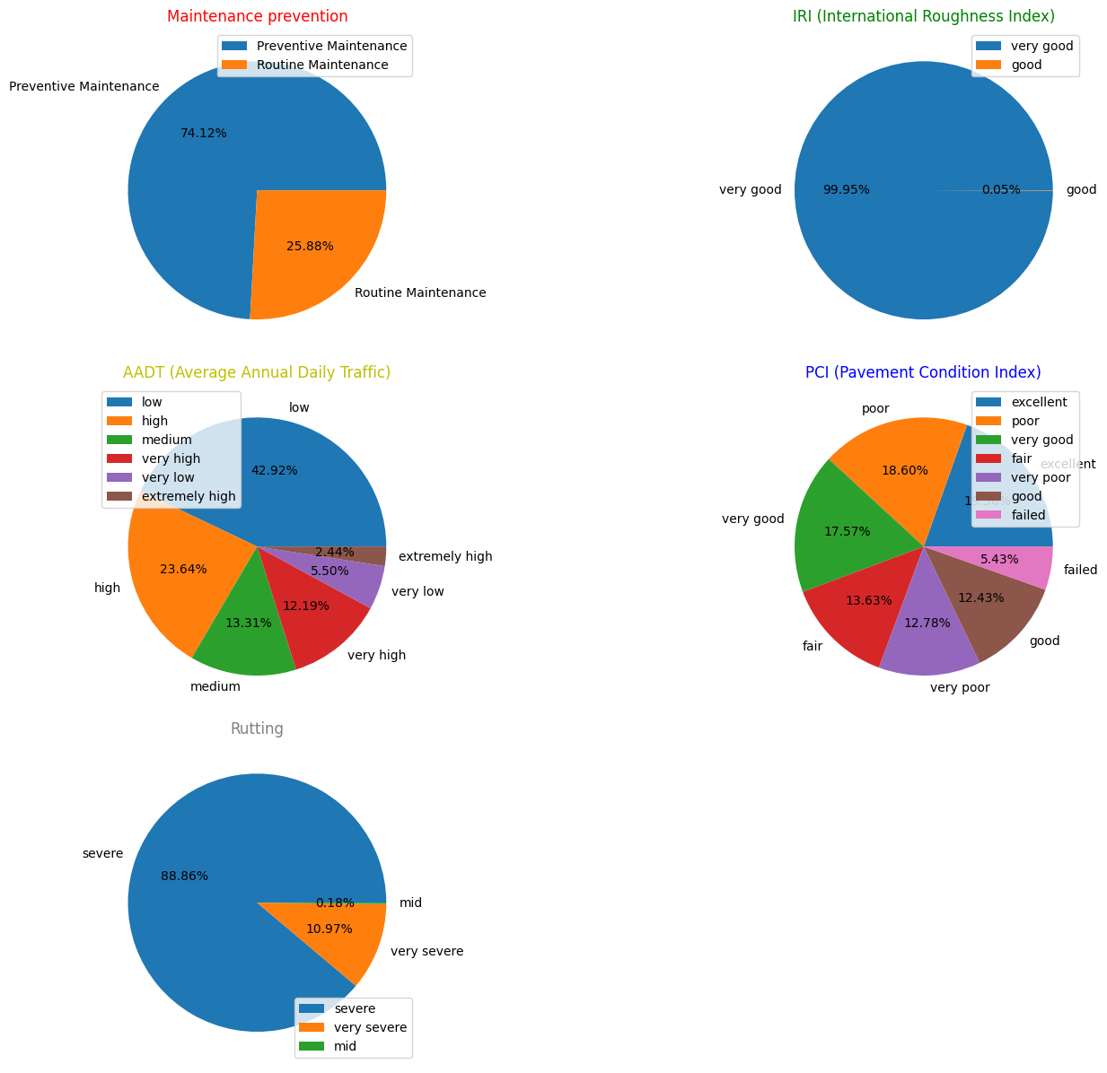
Proportion in Datasets

Slide 6
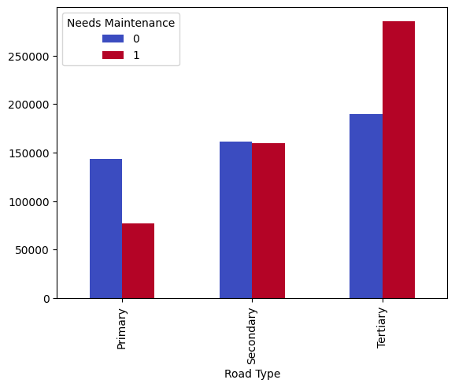
Q1) Does Road Type matters for For Maintenance?
Answer) According to Bar chart Road type matters for the maintenance as in the chart count of Raod which needs maintenance increases with moving from primary to secondary to tertiary.

Slide 7
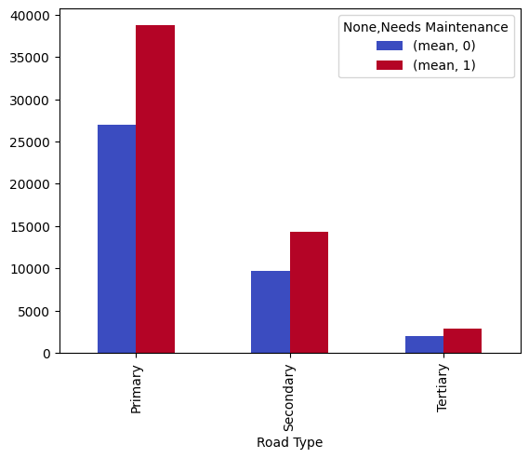
Q2) Does AADT (Average Annual Daily Traffic) affects roads for maintenance?, Does AADT affects diiferently on different type of roads?
Answer) According to bar chart as AADT value increases as roads maintenance chances increases and AADT value does work differently on different type of roads as in the Chart AADT value decrease from Primary to secondary to tertiary which explains that AADT values are high on primary road type and also bar of needed meintnac=nce is high in primary road type.

Slide 8
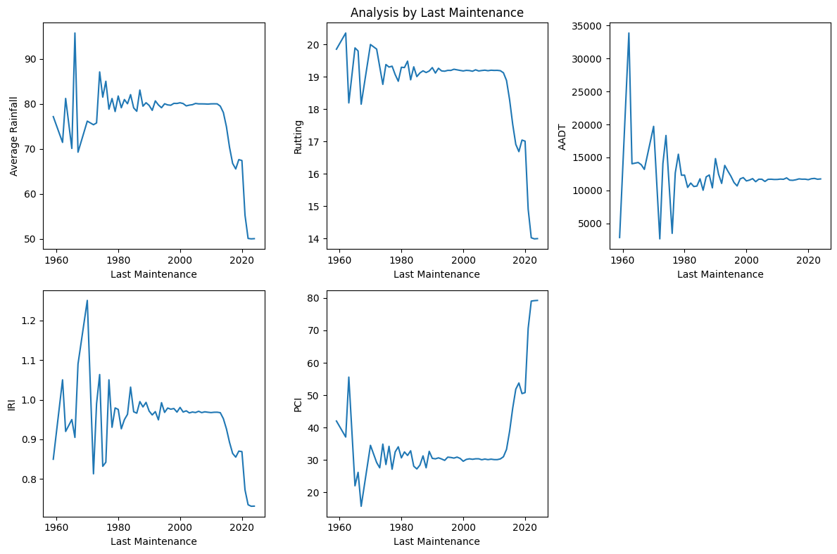
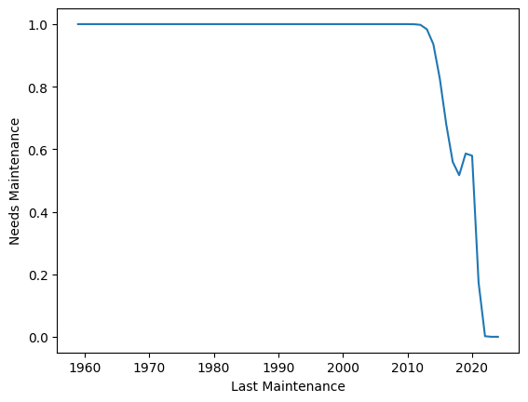
Q3) Does roads or segments maintained recently has less need of maintainance?

Slide 9
Answer Q3) the Roads which were maintaied early has less chances of maintainance needs and has high PCI (Pavement Cindition Index) value and less IRI (International Roughness Index).

Slide 10
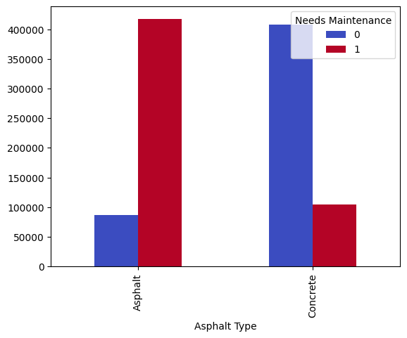
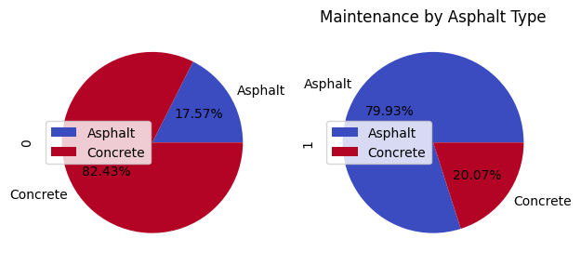
Q4) Which road has more quality between Asphalt and Concrete Road?
Q4 Answer) According to above charts Concrete road has more quality than Asphalt road as they have less number of Segments which needs maintenance.

Slide 11
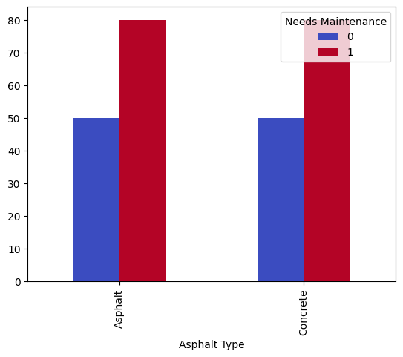
Q5) Does high rainfall increase the chance of maintenance needs on Asphalt and Concrete Roads?
Answer Q5) According to chart high rainfall increases the number of roads which needs maintenance and its applies to both Asphalt and Concrete roads.

Slide 12
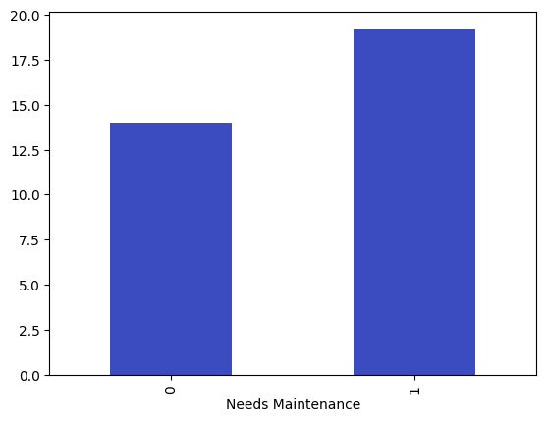
Q6) Does Rutting increases the number of maintenance?
Answer Q6) Yes more the value of rutting increases needs of road or segment maintenance increases.

Slide 13
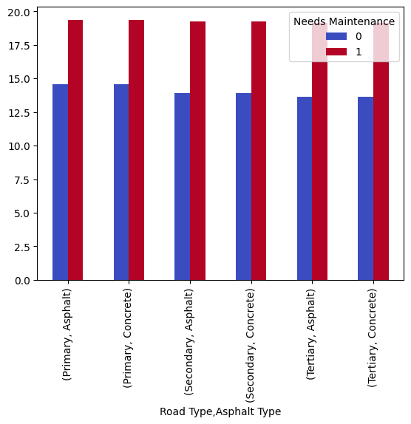
Q7) Does rutting happens or increases on different Types of Roads and segment?
Answer Q7) No, According to above chart rutting occures approximately equal on on every road type.

Slide 14
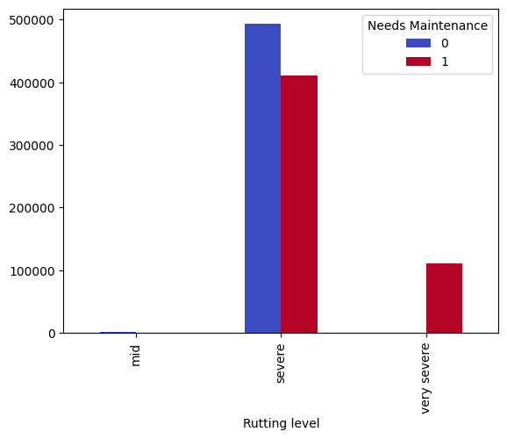
Q8) How Rutting level affects Road Maintenace?
Answer Q8) If Rutting level is very severe than it needs Maintenance if Rutting level is at severe then need of mantenance has no need of maintenance has little difference.

Slide 15
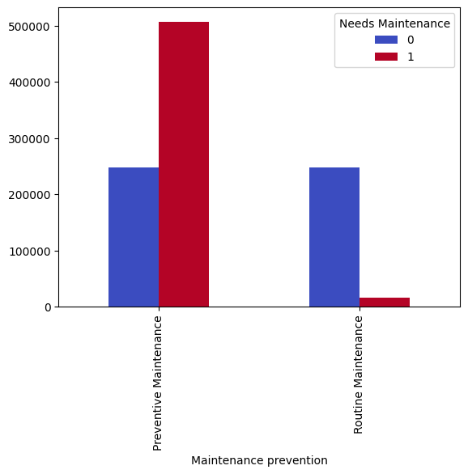
Q9) How last maintenance affects maintenace needs of Road?
Answer Q9) If Road or segment is maintained before 2021 than road maintainance need chances are very high.

Slide 16
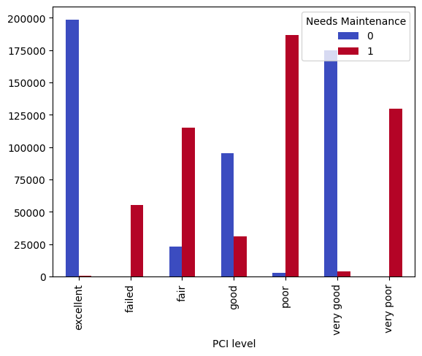
Q10) How PCI(pavement Condition Index) affects maintenace needs of Road?
Answer 10) According to above chart if PCI level is very poor then road need maintenance and if PCI level is excellent it doesnot need maintenace, overall if PCI level decreases it increases the need of maintenance.

Slide 17
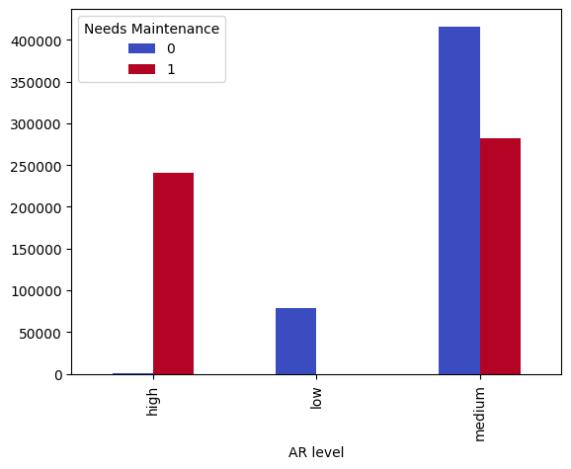
Q11) How Average Rainfall level effects the Road maintenance?
Answer Q11) According to above chart if Average rainfall level is low than road doesnt need maintenance and if average rainfall is high than road needs to be maintained, As Average Rainfall increases it increases te chances of need for road maintenance.

Slide 18
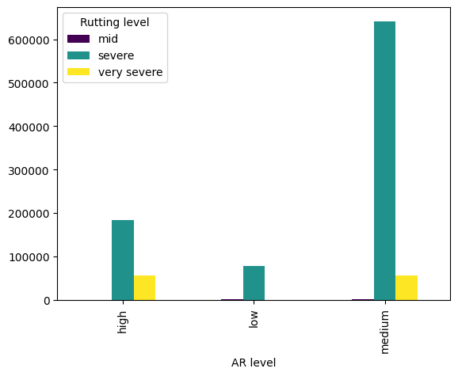
Q12) Does average rainfall increases Rutting on Road?
Answer Q12) Yes, As Average Rainfall level increases the rutting level also increases.

Slide 19
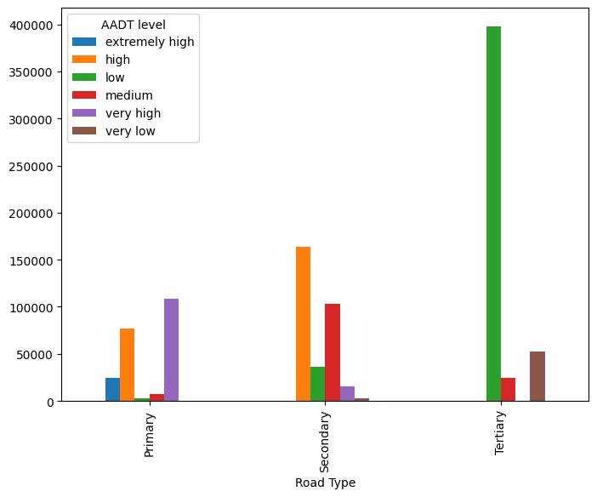
Q13) Does traffic value depends on road type?
Answer Q13) Different roads has different level of traffic as in above chart at tertiary road there is low level traffic and at primary level road the traffic level are very high.

Slide 20
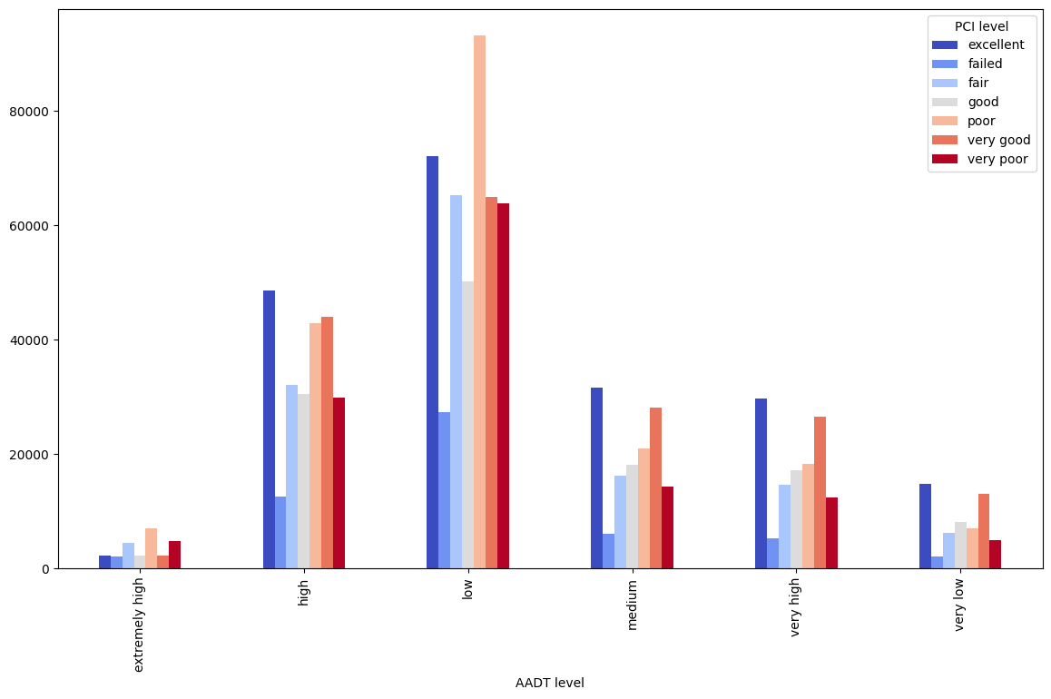
Q14) Does Pavement condition increases with low traffic or high traffic?
Answer Q14) According to above chart lower the traffic better the condition of Pavement will be.

Slide 21
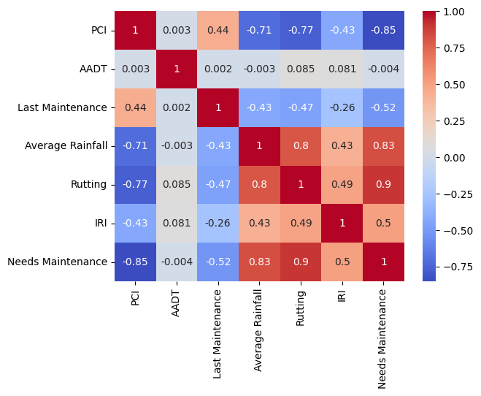
Q 15) Calculate relationship betwwen valriables(features).

Slide 22
Model Training
Libraries (Pandas, Numpy, Matplotlib, Seaborn, Scikit-learn)
load dataset
Encoding and Scaling
Data Split
Select Algorithm or Model
Select best model
Save the Model

Slide 23
Best Model
Random Forest Classifier
RandomForestClassifier(n_estimators=200)
Accuracy : 99.997%( approximately 100%)

Slide 24
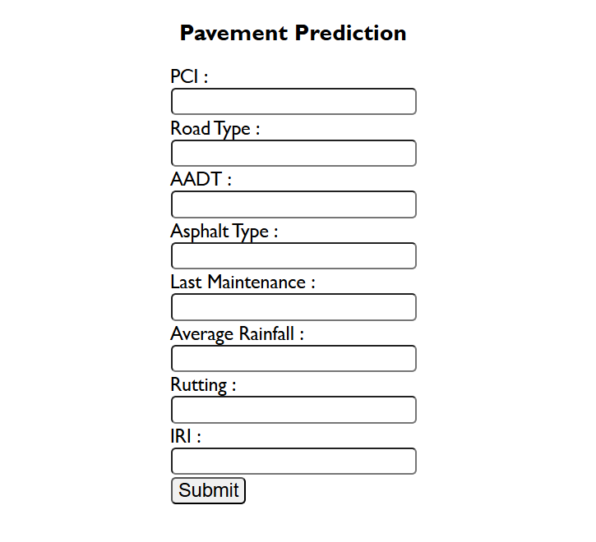
User Interface
HTML, CSS and Flask.

Slide 25
Thank You

